Slide 1
World Refugee Forecast
Nathaniel Arnold | Ashley Overman | Basheer Eljabaly | Rishi Khanna

Slide 2
Purpose
Initial intent: overlay war/conflict, natural disasters, persecution
Due to time constrains: famine
Why do people seek refuge in other countries?
Forecast regions/countries that may experience a large influx of refugees

Slide 3
Goals accomplished
Analyze refugee data (statistics and distribution) to correlate
Divergence of mean
Poisson distribution
Select a sample of countries (because there are many in the data set we’ve been working with) in specific to analyze
Further analysis to determine a major factor (food deficit) – in progress

Slide 4
Data sets
Primary data set analyzed: Asylum Seekers (Monthly) from the UN Refugee Agency
Discrepancy/human error possibility – given values only account for refugee numbers reported
Doesn’t take into account illegal immigrants/refugees
Other data sets used: Food Deficit, GDP per capita (US$), Imports and Exports, Asylum Seekers, Happiness Index
Majority from the World Bank
Didn’t fully develop models for all of these (ran out of time)

Slide 5
Refugee Data: Initial Impressions
Initial findings in annual data show that most refugees come from Middle Eastern countries
Countries with the highest asylum seeking population were also in the Middle East and adjacent to countries that have high refugee populations
Hypothesis: Most refugees fled to adjacent/neighboring countries
Analysis on previous slide (just through top 5 in terms of refugee population) don’t show this.
Most refugees flee to countries that are further away from their home country
Top countries from both data sets (Afghanistan and Syria) analyzed to validate analysis
Follow up: Overriding factor that will drive people to certain countries over others (language barriers, cultural/racial differences, etc. in favor of something else)

Slide 6
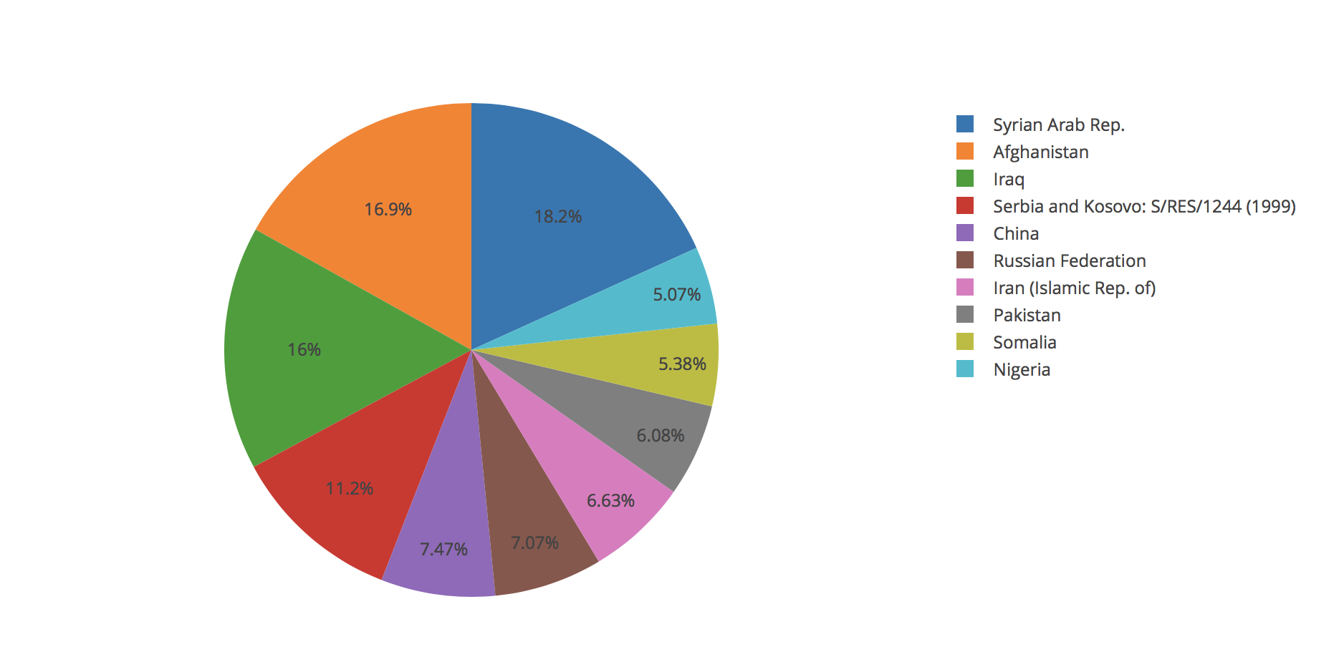
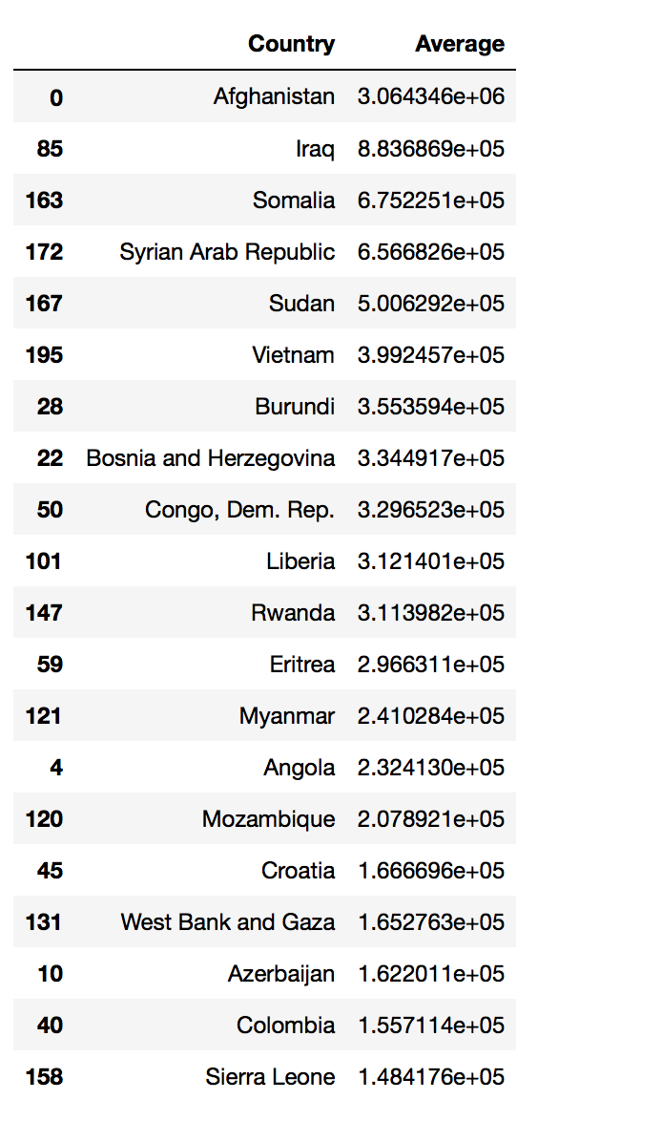
Top 10 Countries of Origin by Year
(World Bank Dataset)
Top 10 Countries of Origin by Month
(United Nations Dataset)

Slide 7
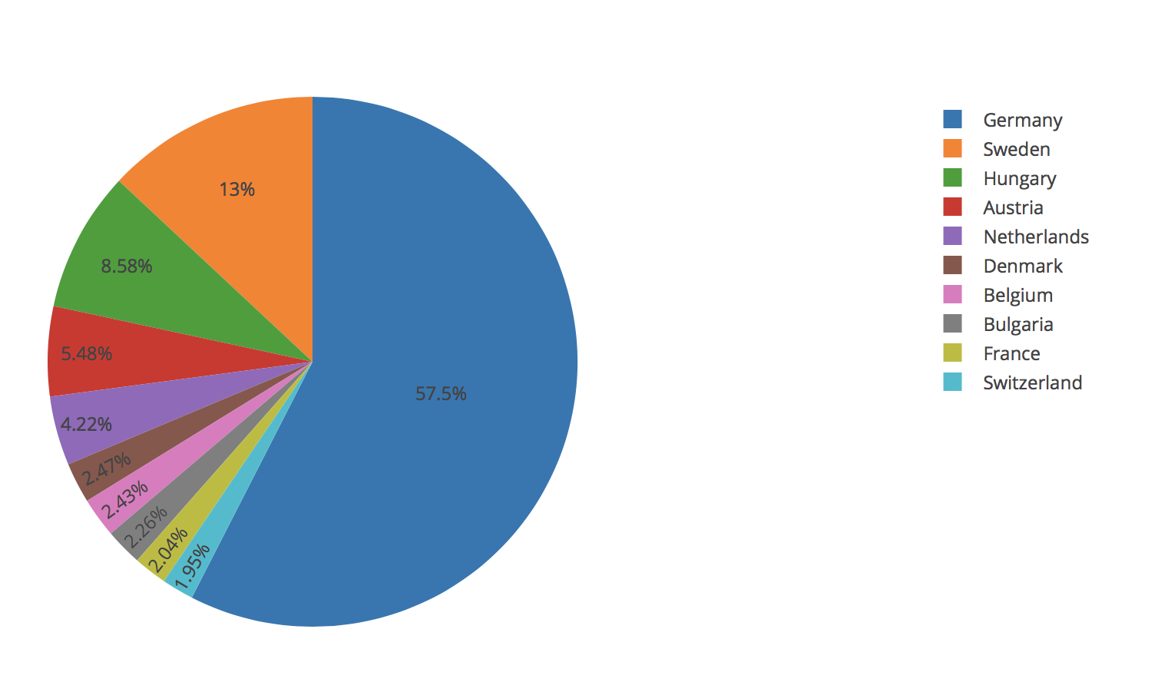
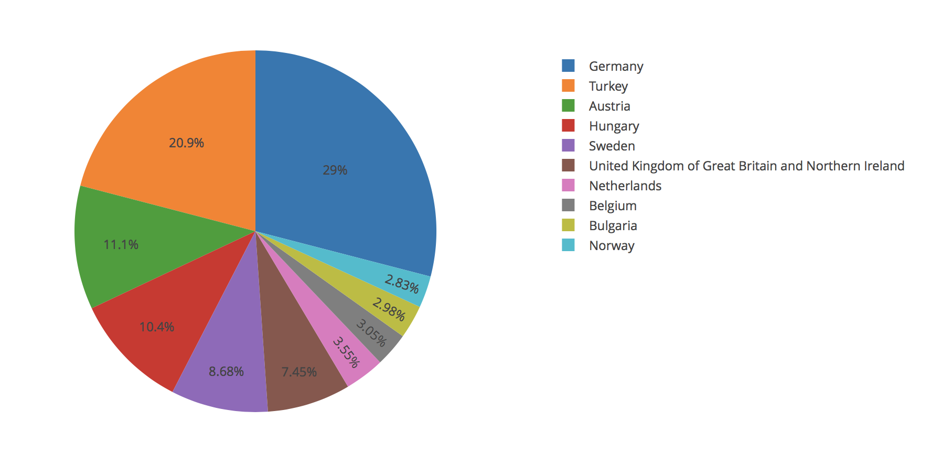
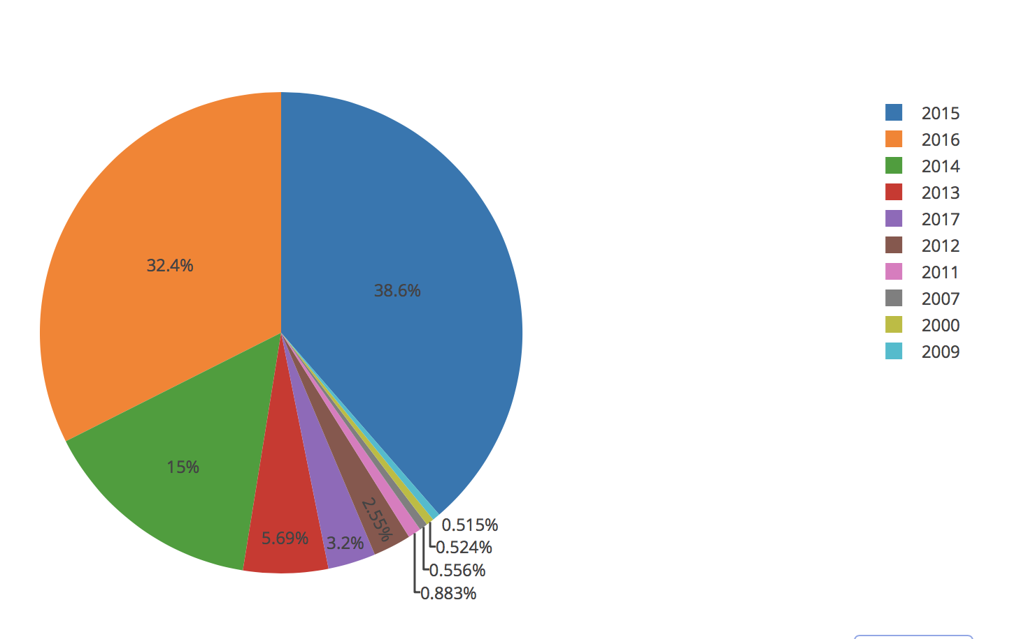
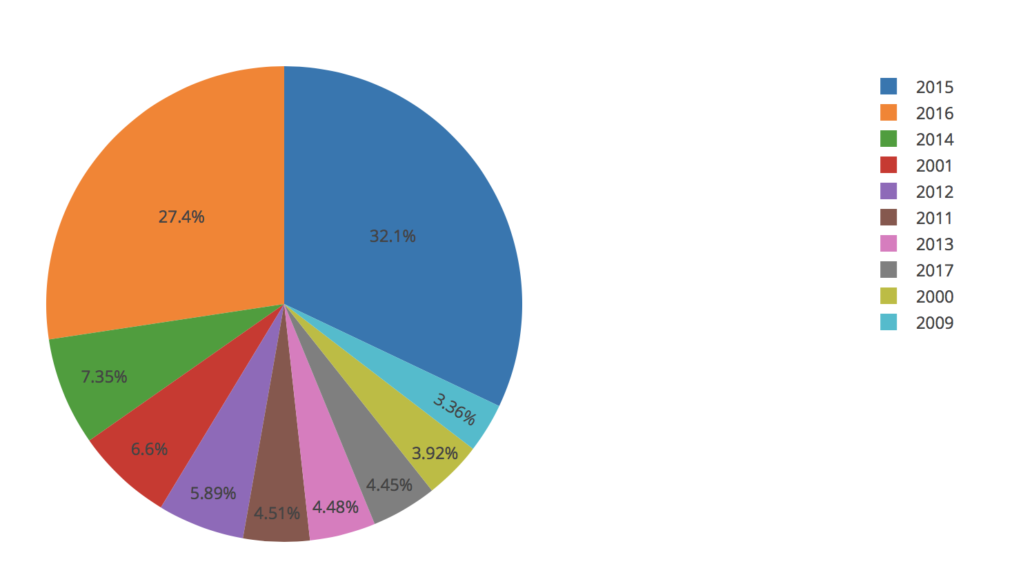
Afghanistan – Top 10 Countries of Asylum and Top 10 Years of Emigration
Syria – Top 10 Countries of Asylum and Top 10 Years of Emigration

Slide 8
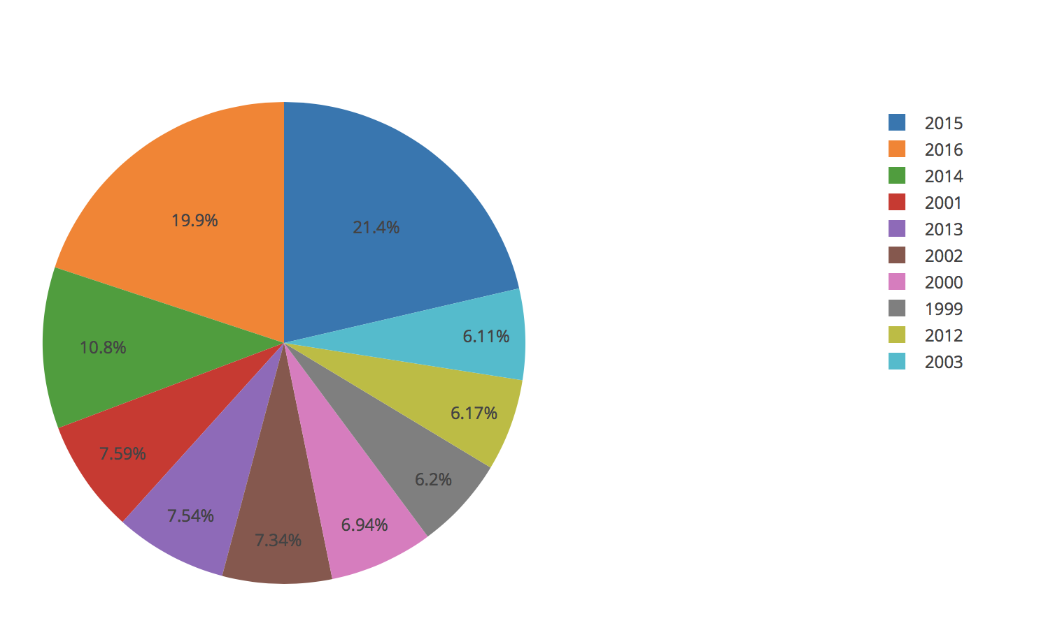
Top Ten years with the highest Number of refugee Traffic

Slide 9
Centroid Analysis
Maps the path from country of origin to country of asylum based on country centroids
Model for 2015
Most heavily trafficked year
Models can be developed for other years as well

Slide 10
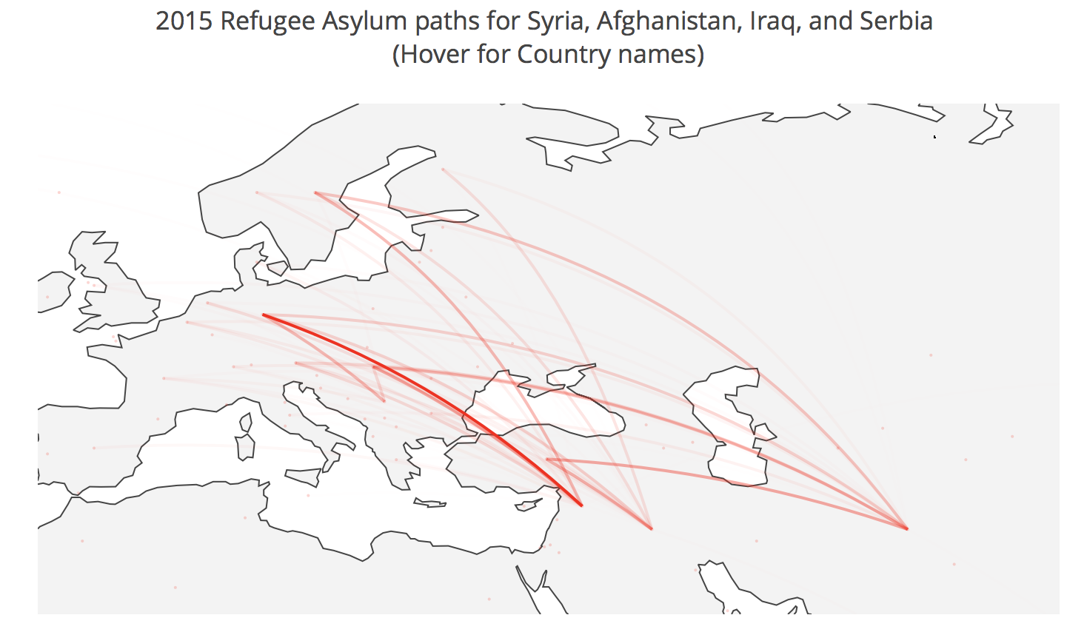
Centroid analysis: 2015
Finland
Sweden
Germany
Serbia
Syria
Iraq
Afghanistan

Slide 11
Divergence of mean
Best displayed with density plots and indicator lines for mean, median and standard deviation
In almost all countries chosen, the mean is greater than the median
Indicates right skewed data
Outliers to the right of the data

Slide 12
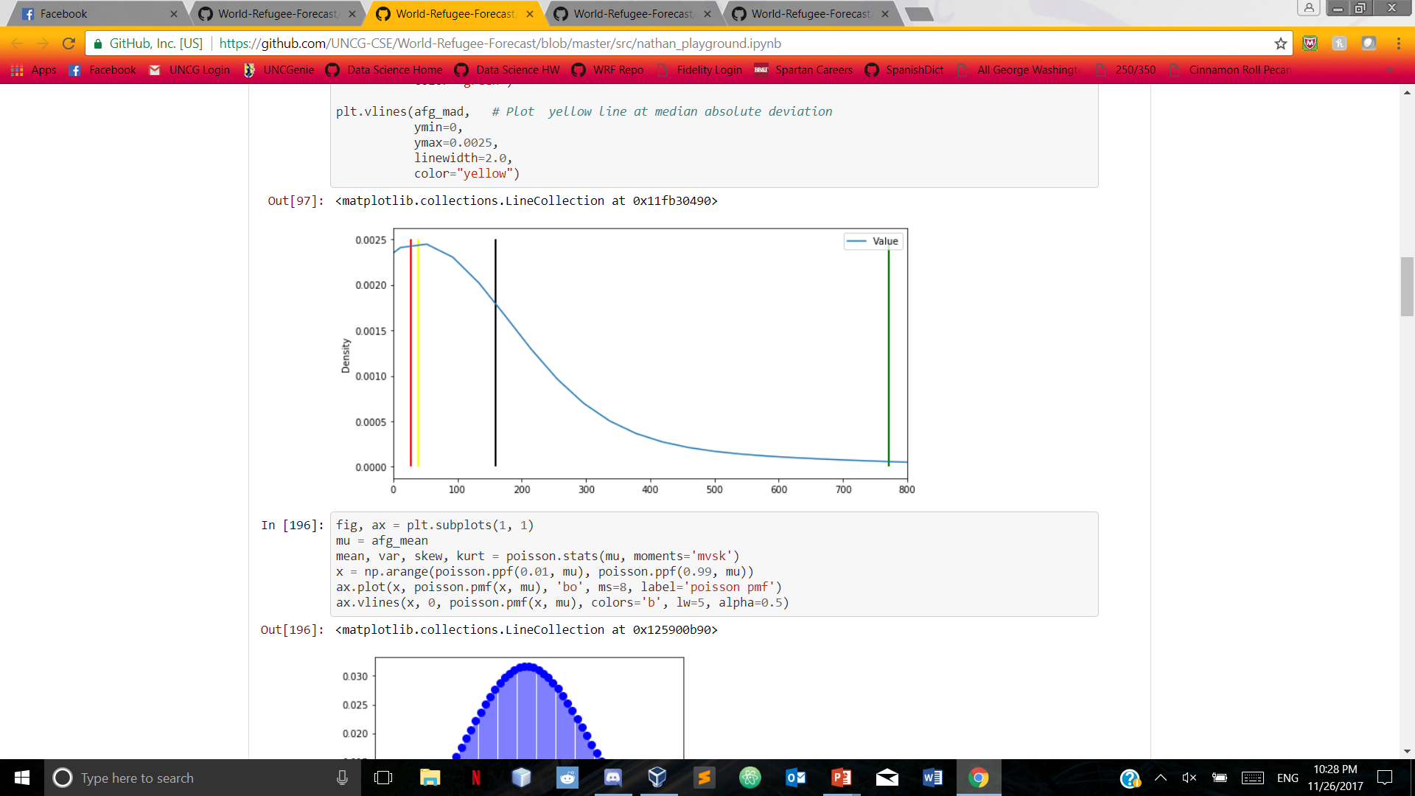
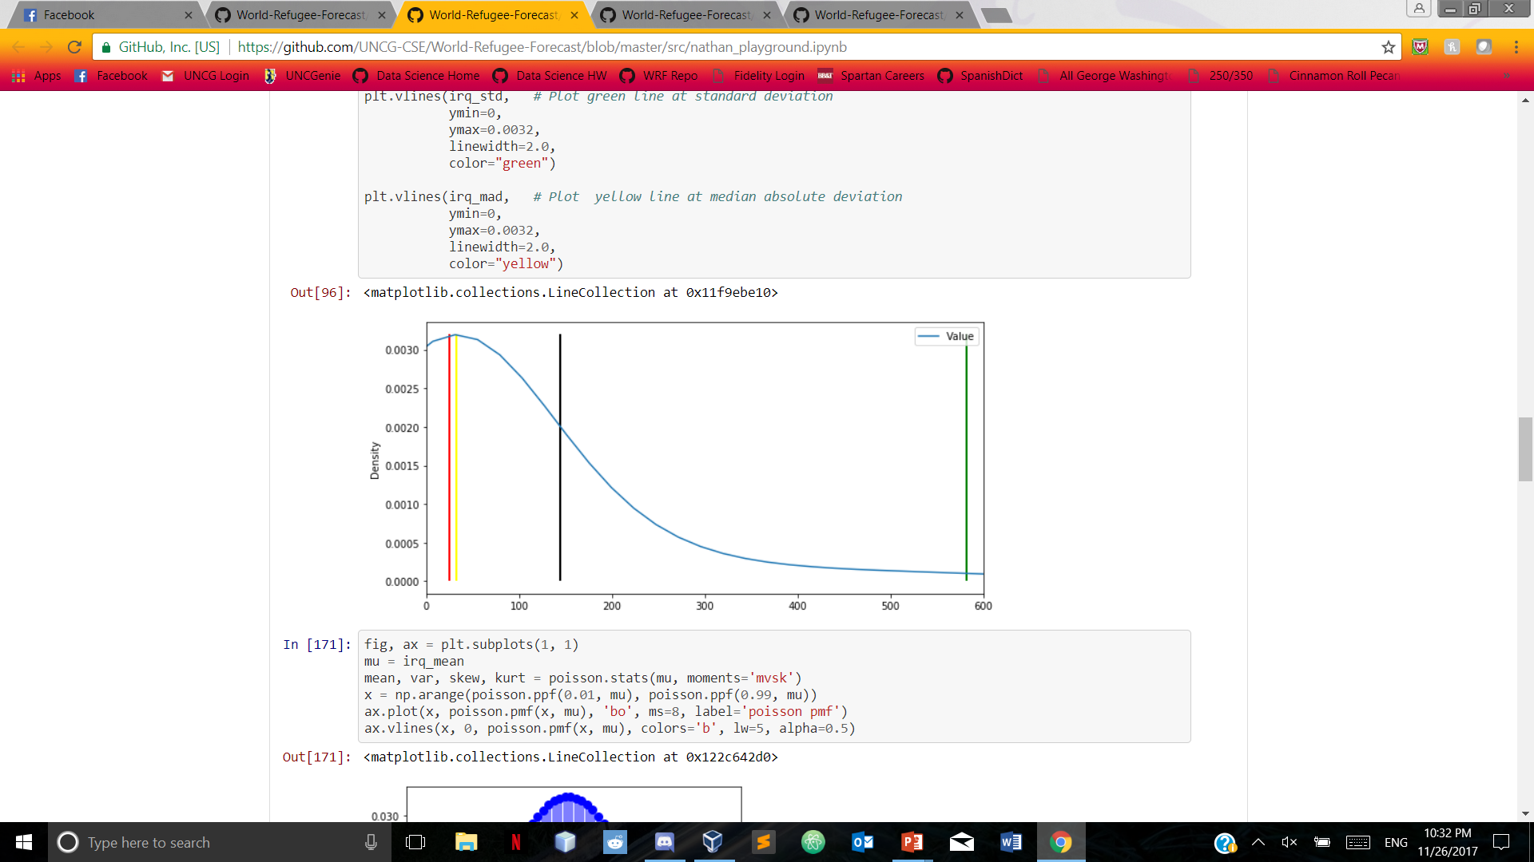
Divergence of mean Afghanistan iraq
Black line indicates mean, red line indicates median, green line indicates standard deviation, yellow line indicates median absolute deviation

Slide 13

Ness index
Happiness index indicates how happy the citizens of a nation are with the current state of the nation
Measured based on various factors (family, economy, freedom, happiness, government, health)
Selected top five countries over three years (2015, 2016, 2017)
Top five countries for 2015: Germany, Hungary, Italy, Sweden, Turkey
Top five countries for 2016: France, Germany, Italy, Switzerland, Turkey
Top five countries for 2017: France, Germany, Italy, Sweden, Turkey

Slide 14
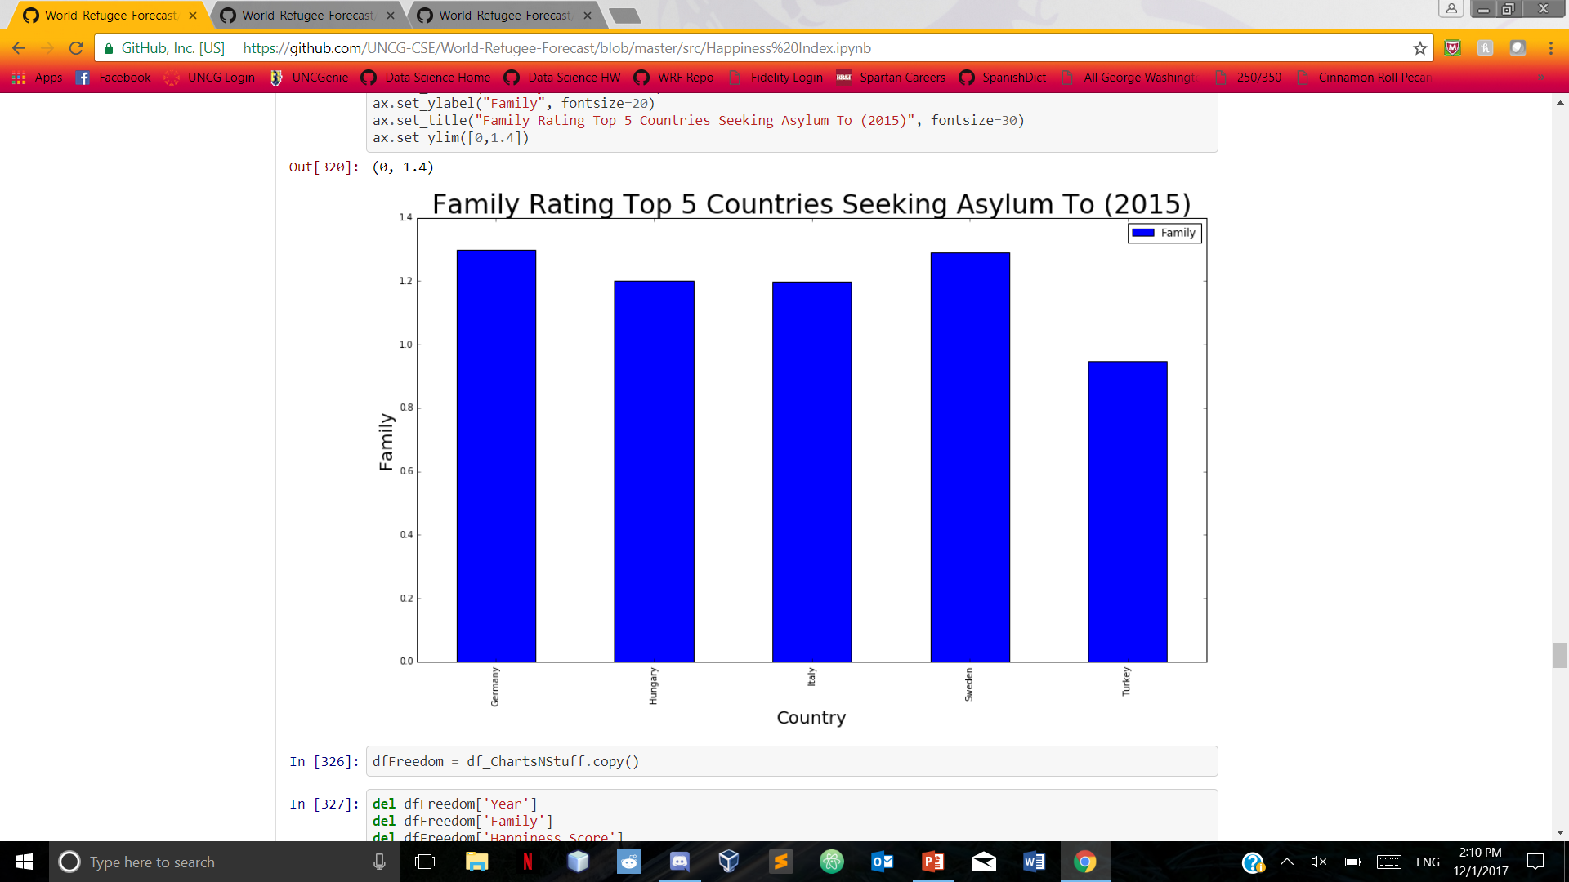
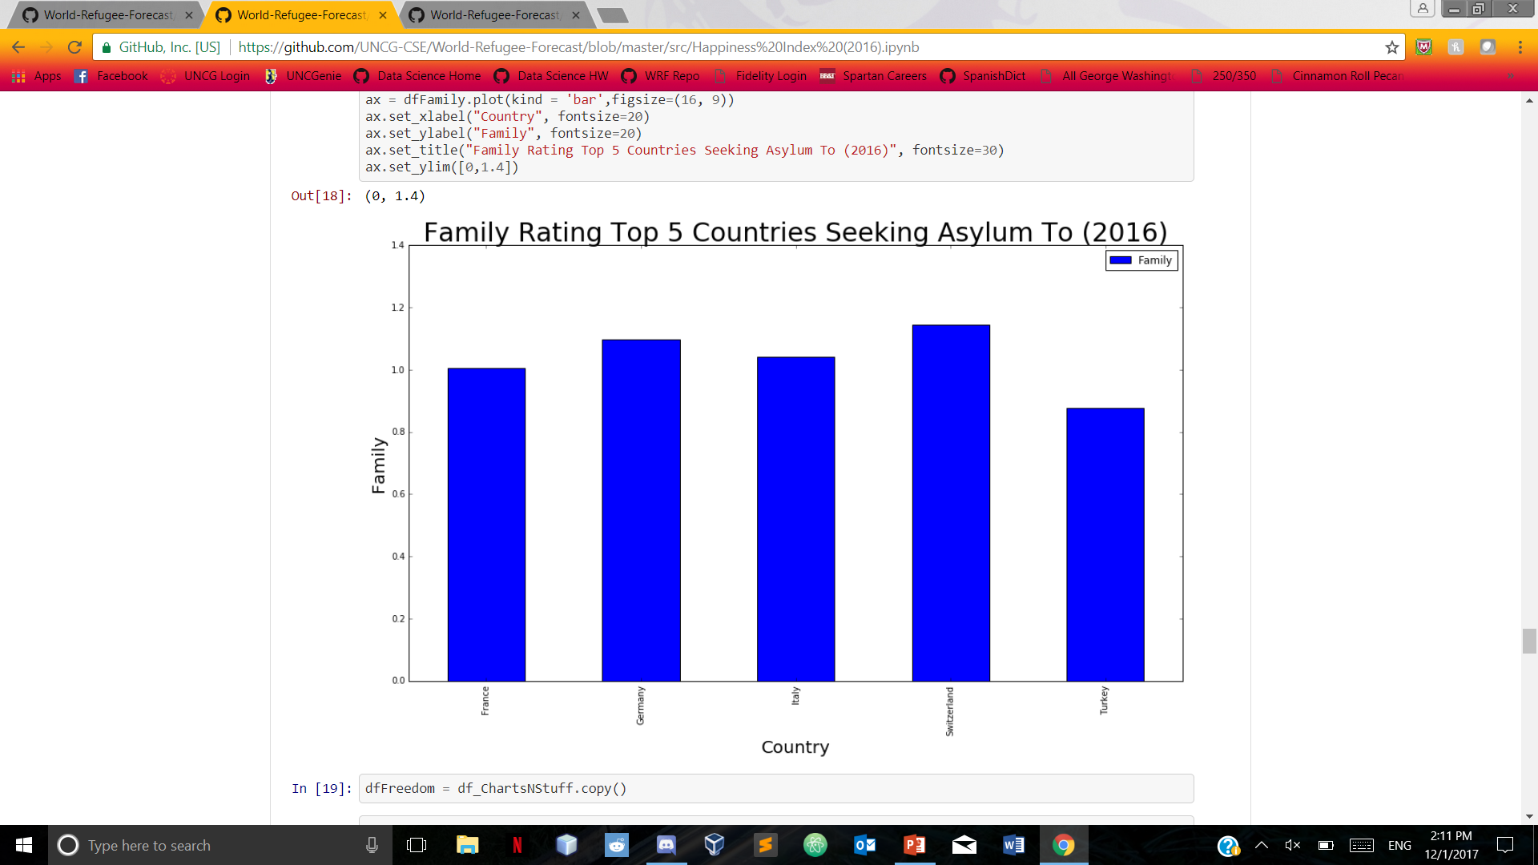
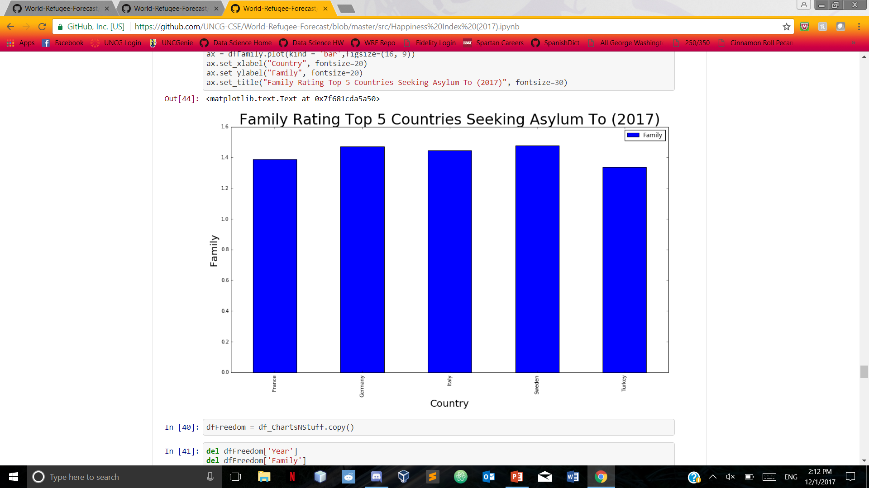
Happiness Index based on Family

Slide 15
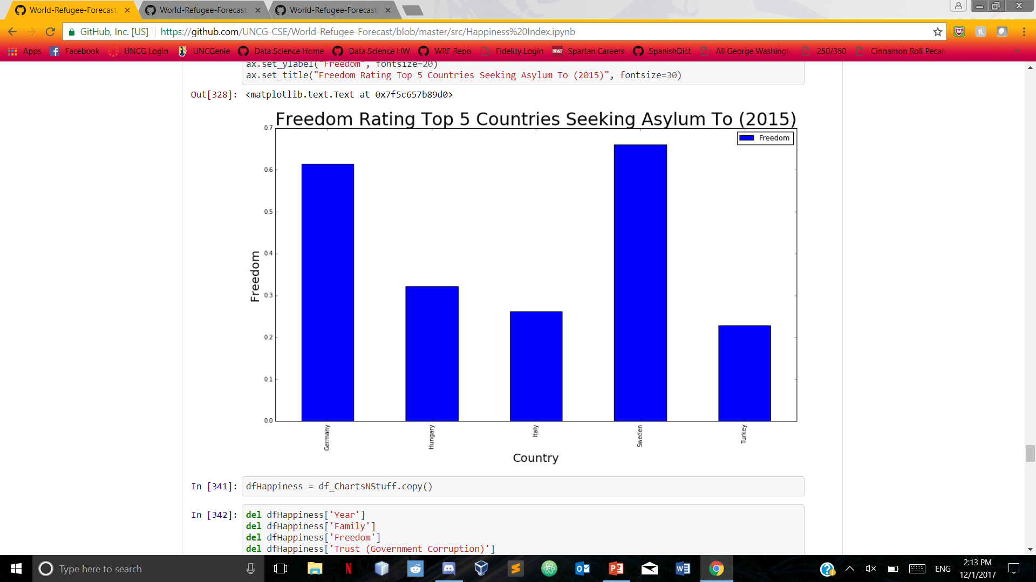
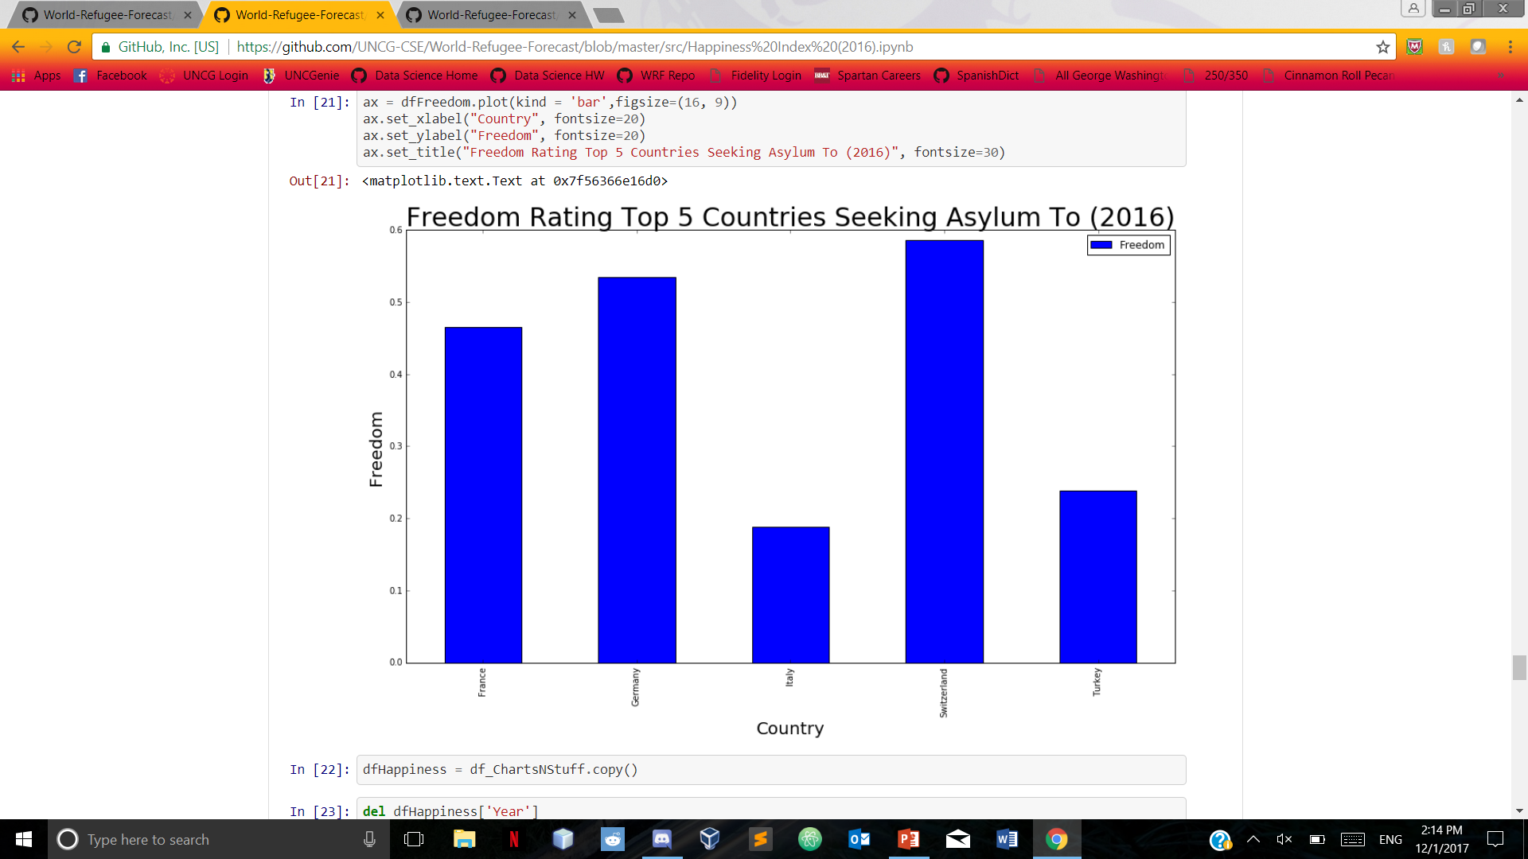
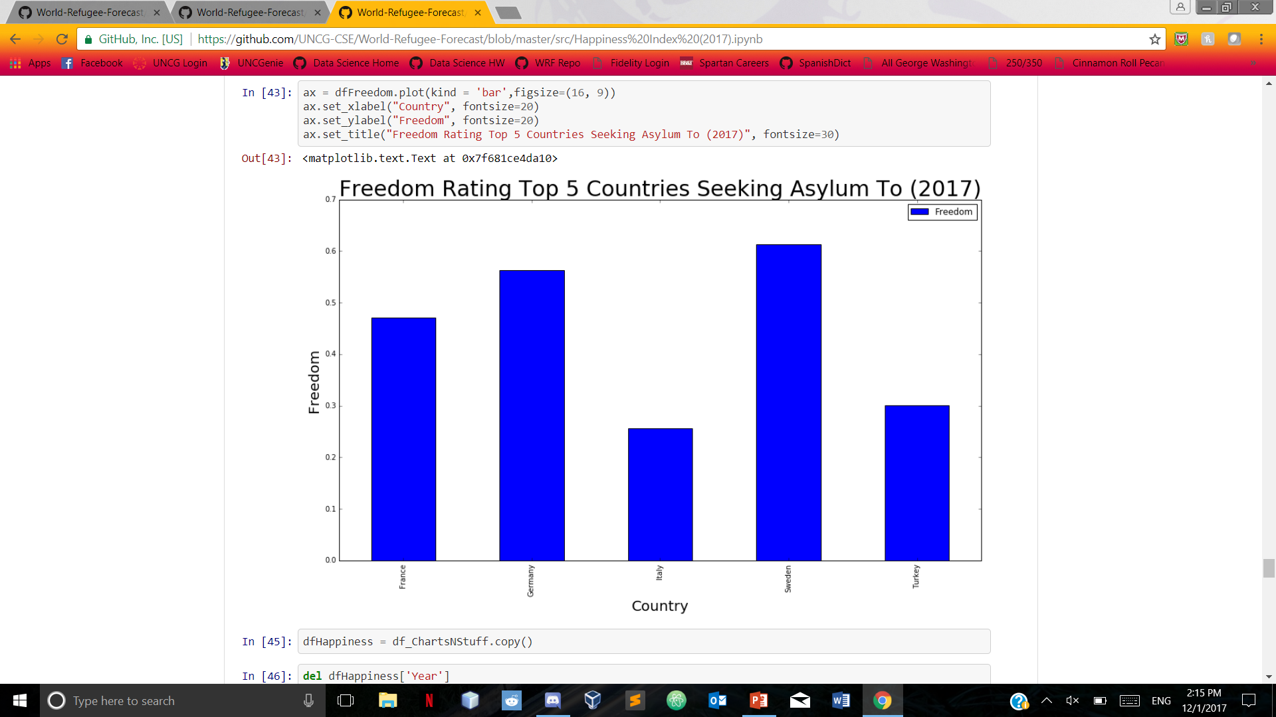
Happiness Index based on Freedom

Slide 16
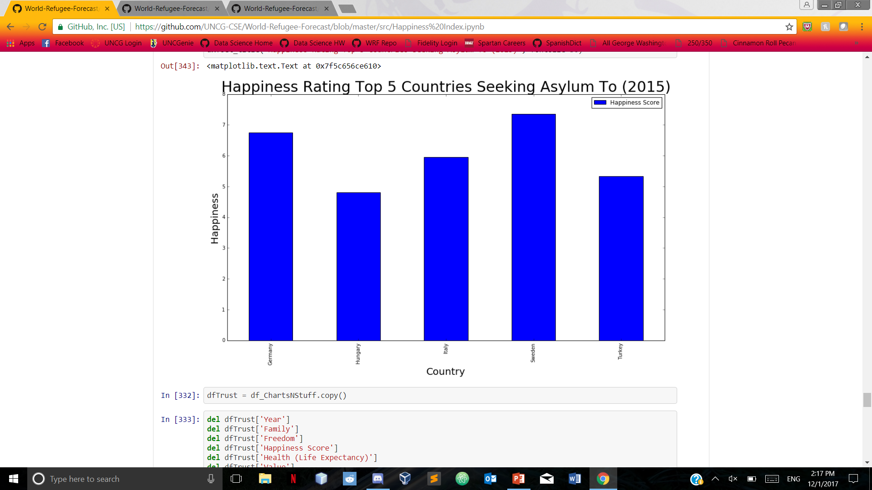
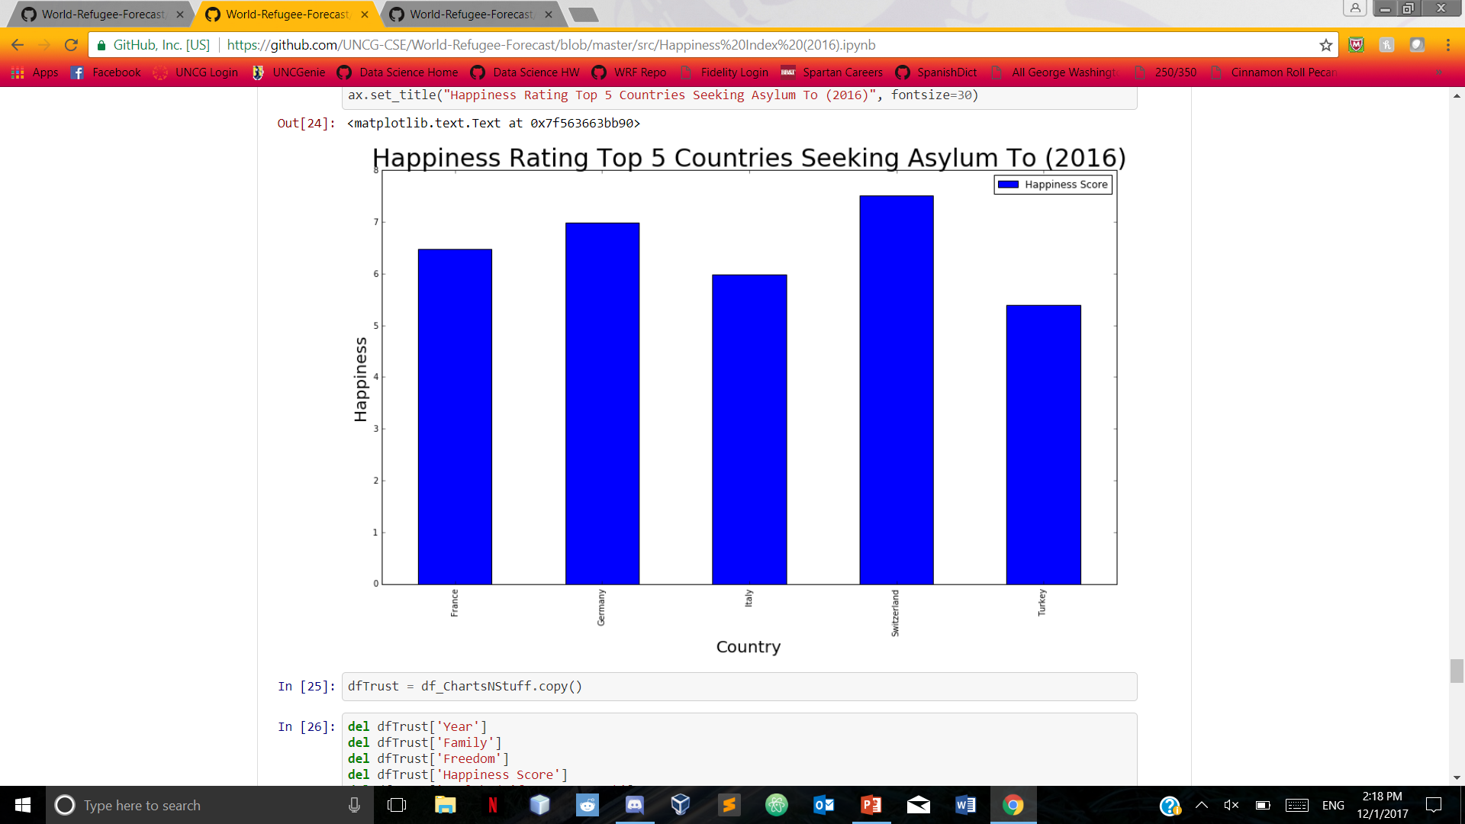
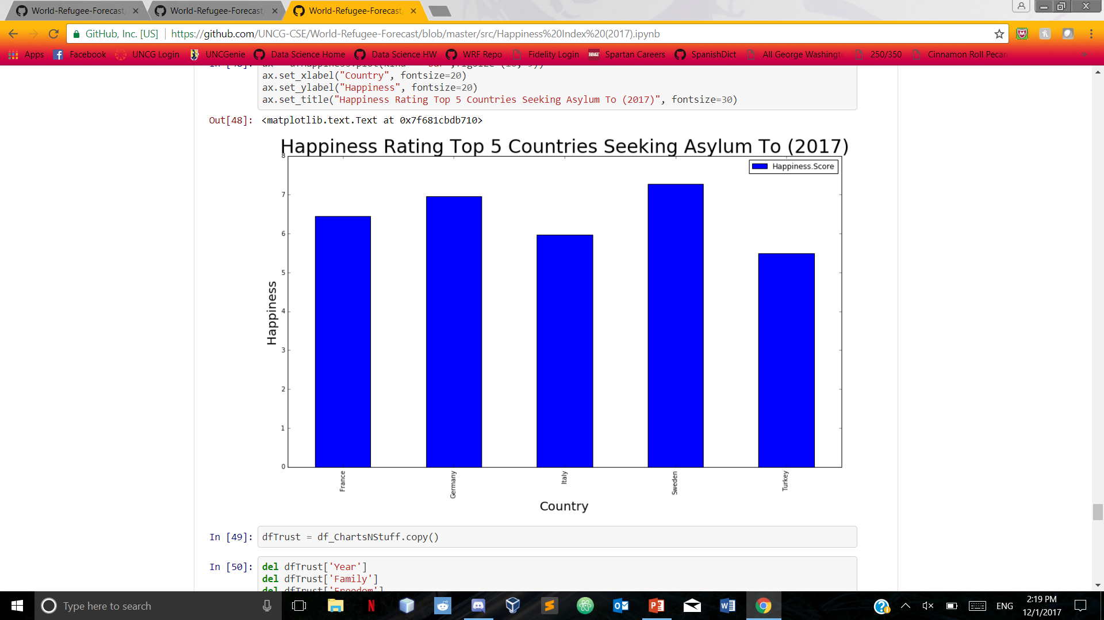
Happiness Index based on Happiness

Slide 17
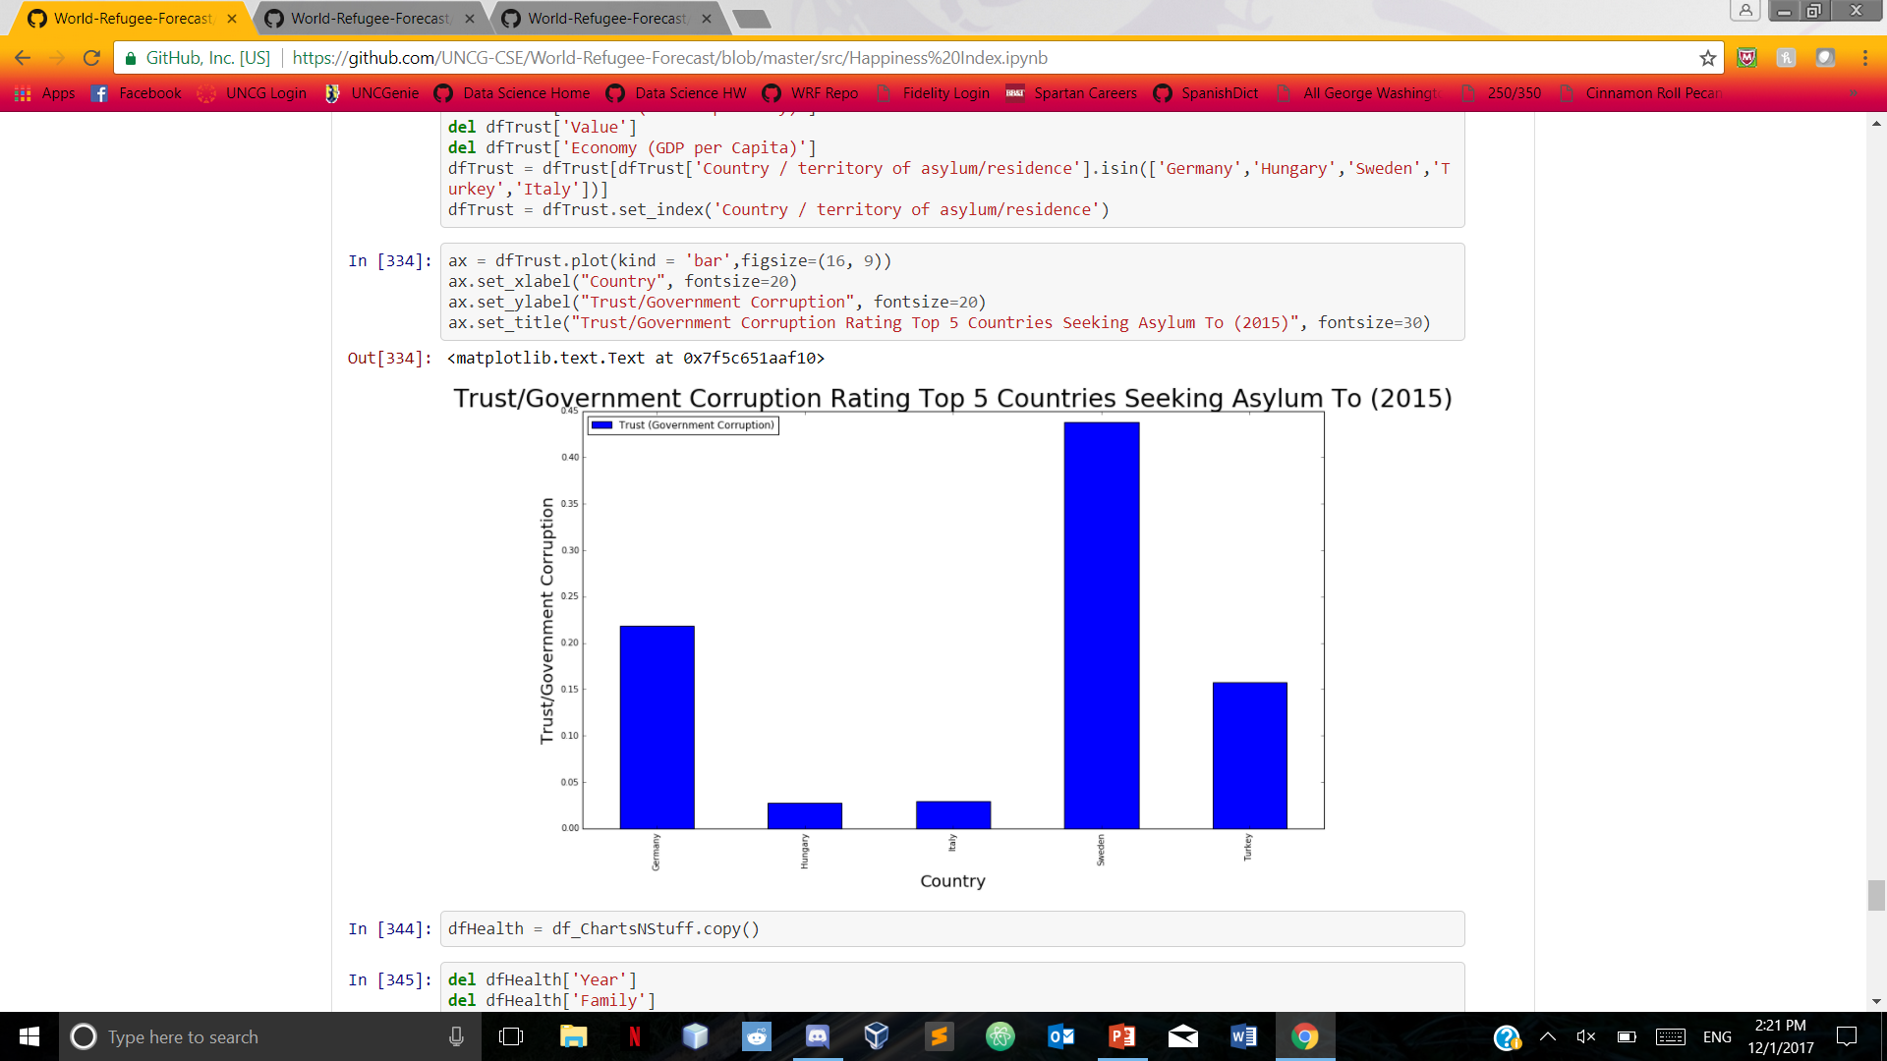
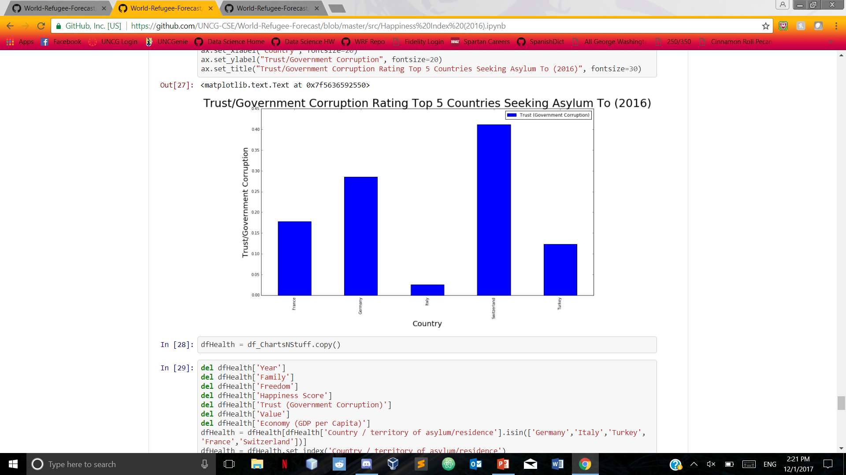
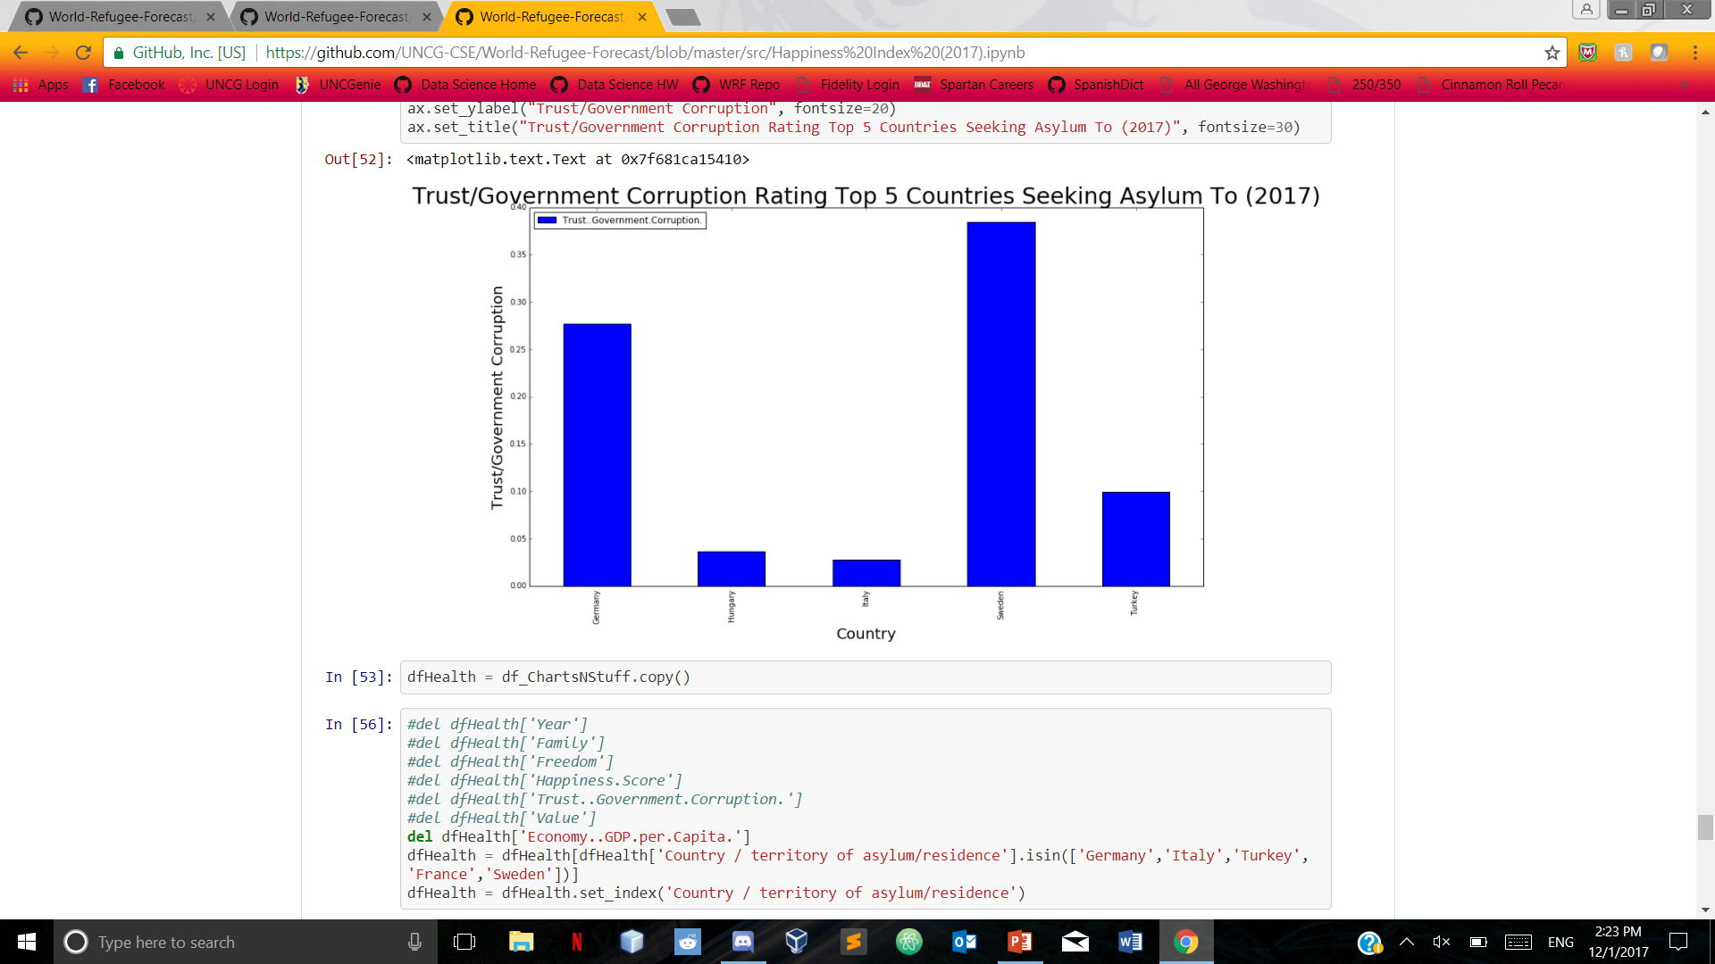
Happiness Index based on Government Trust/Corruption

Slide 18
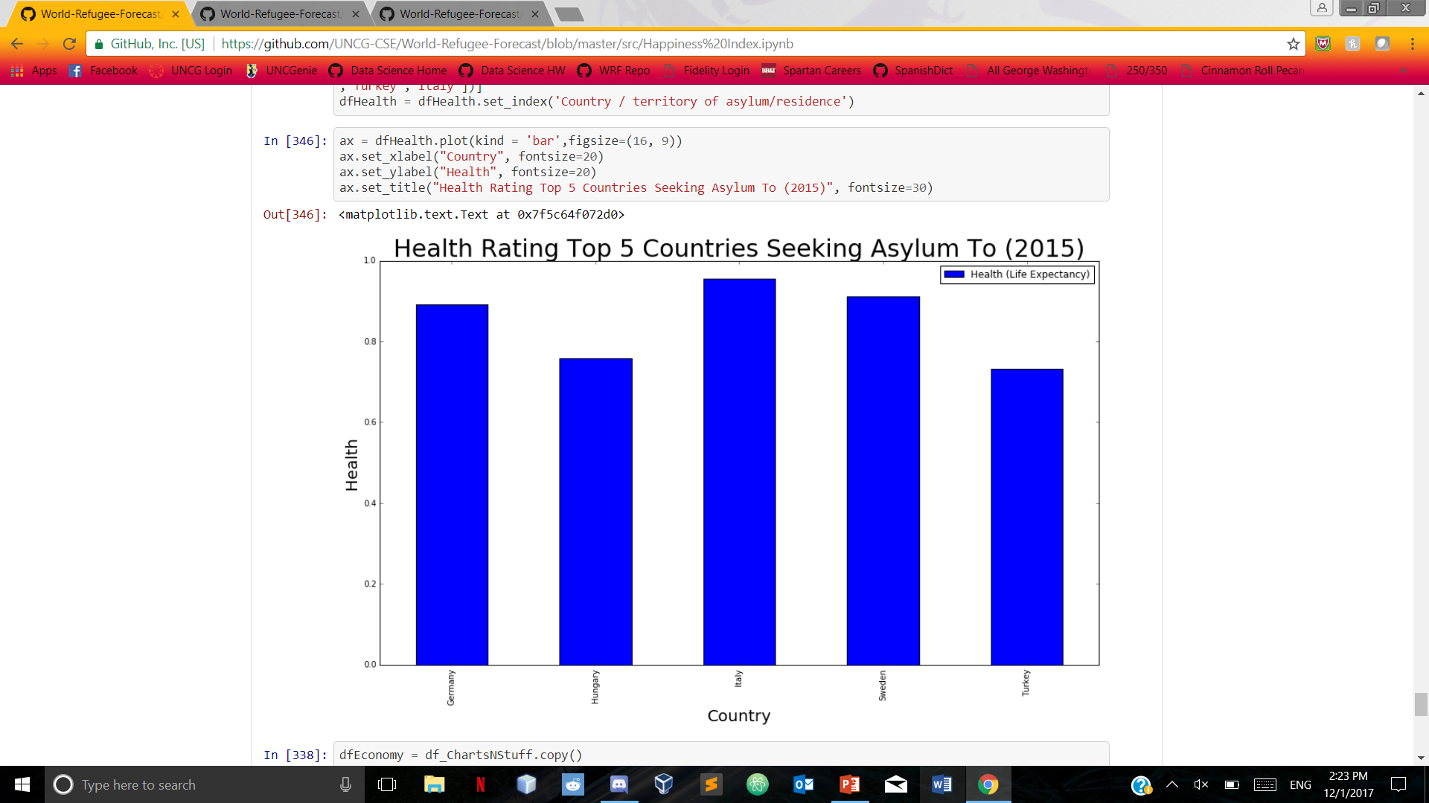
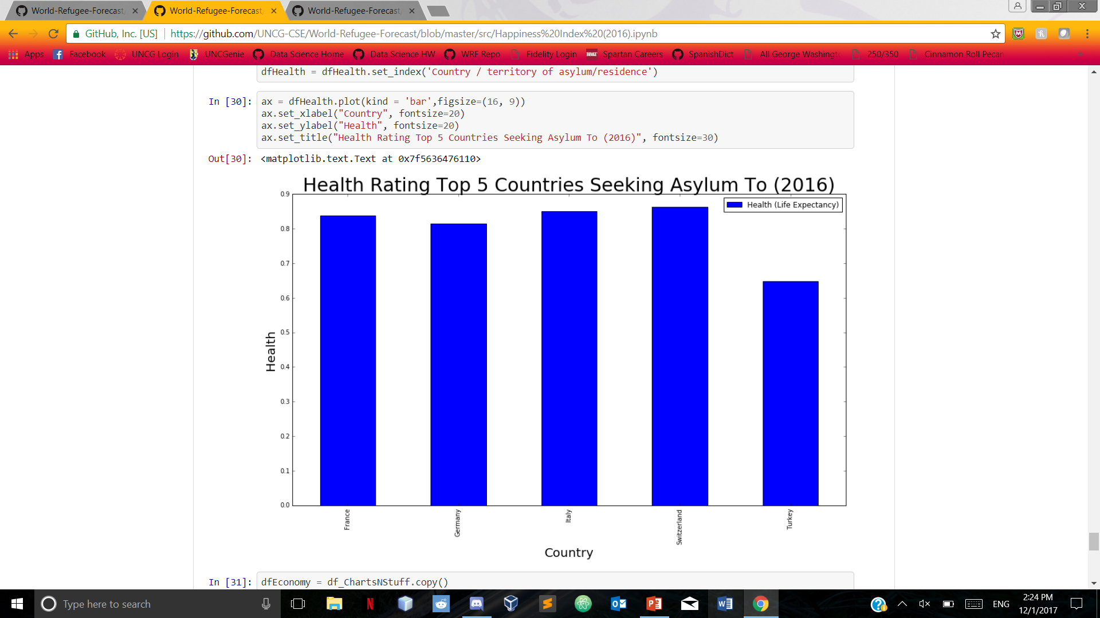
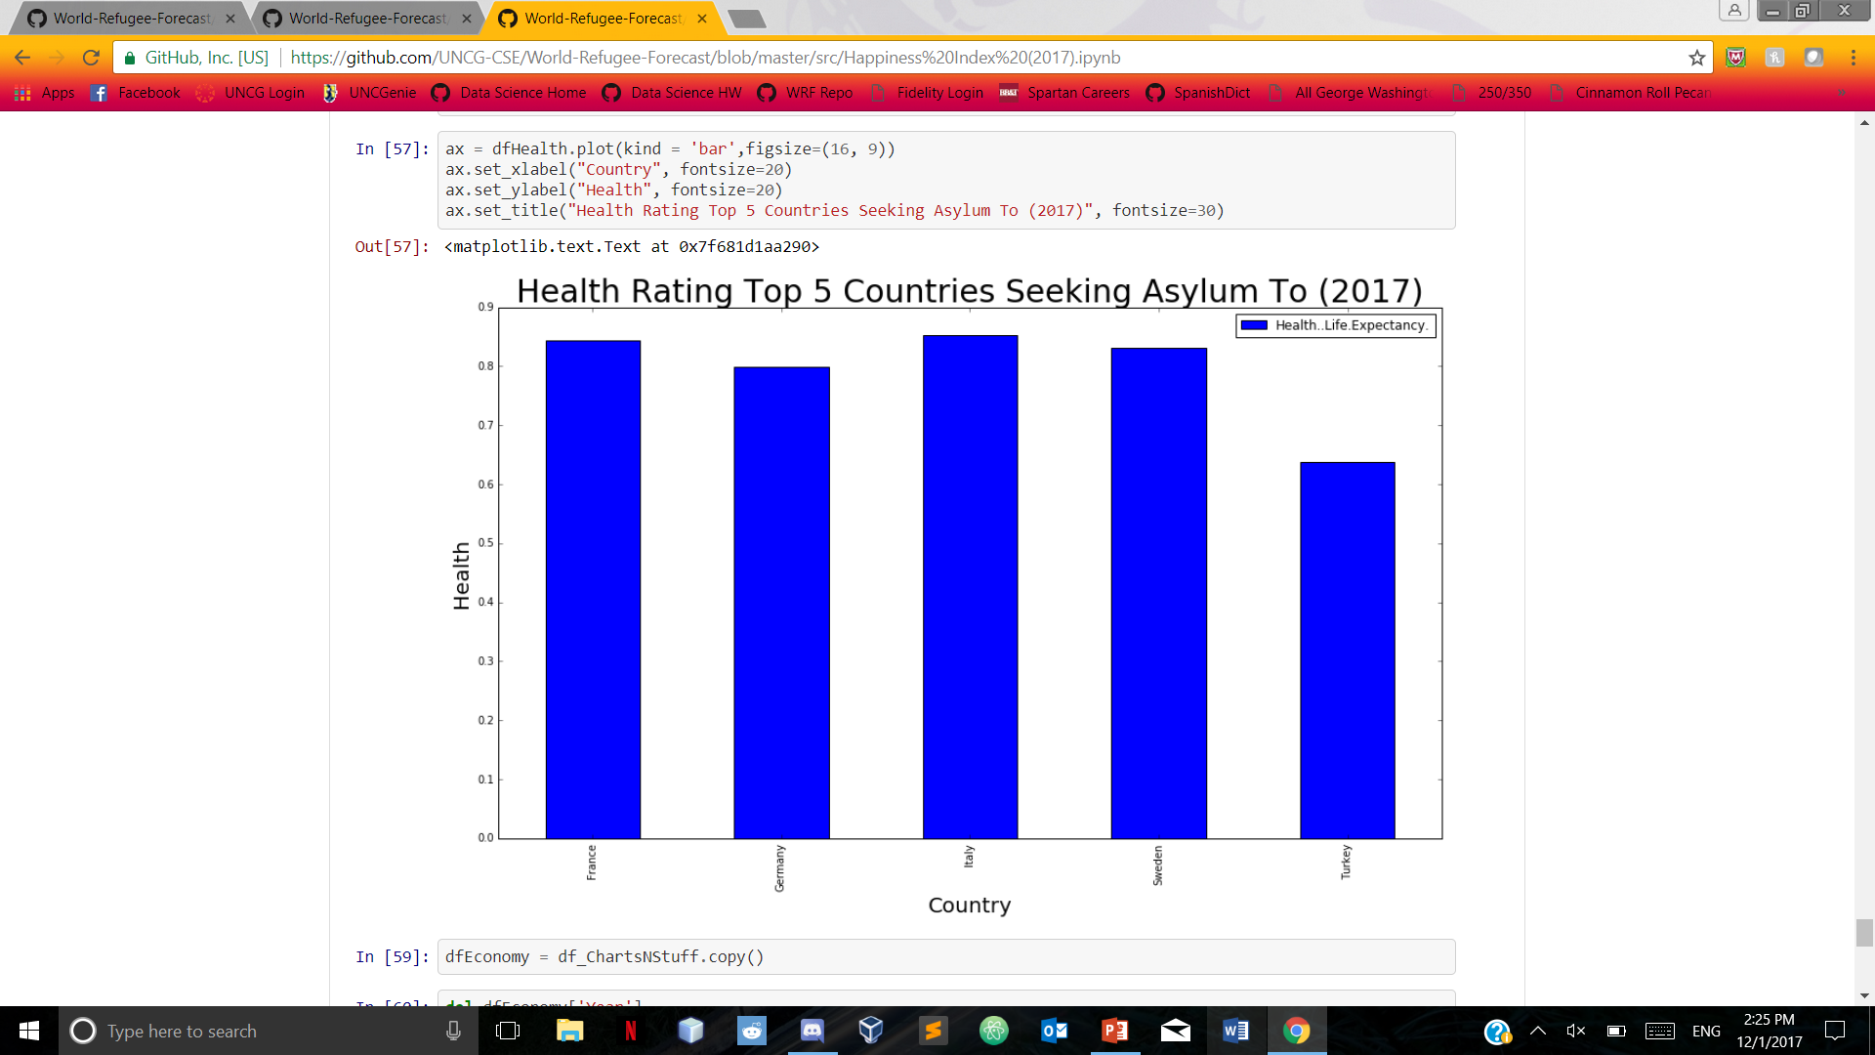
Happiness Index based on health

Slide 19
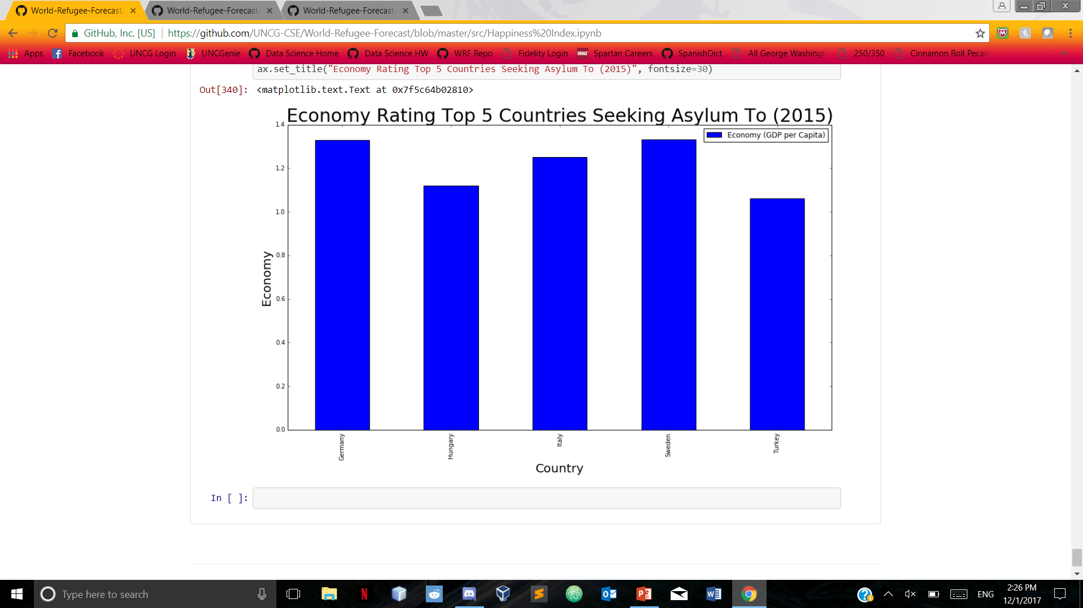
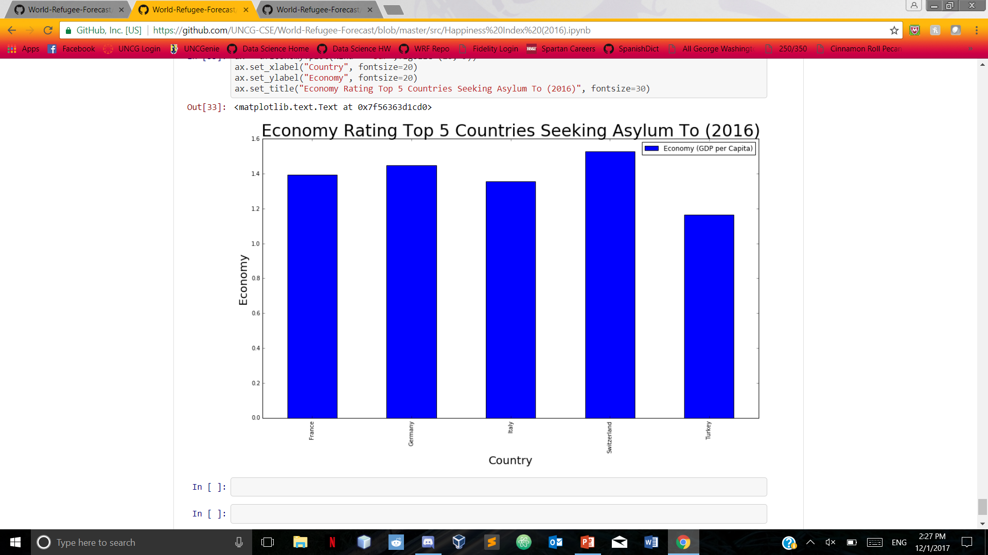
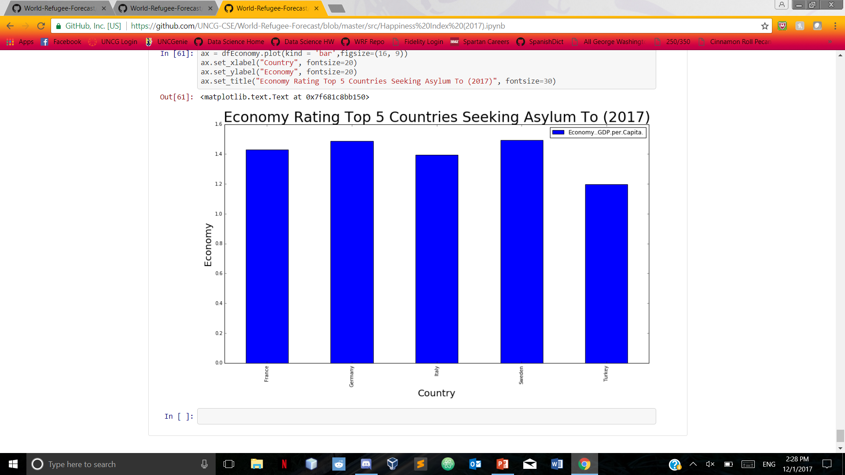
Happiness Index based on Economy

Slide 20
Linear regression
We picked a few countries to analyze using linear regression
Analyzed them alongside the food deficit data to determine if there was any relation to the food deficit and the number of people fleeing the country
Also analyzed GDP

Slide 21
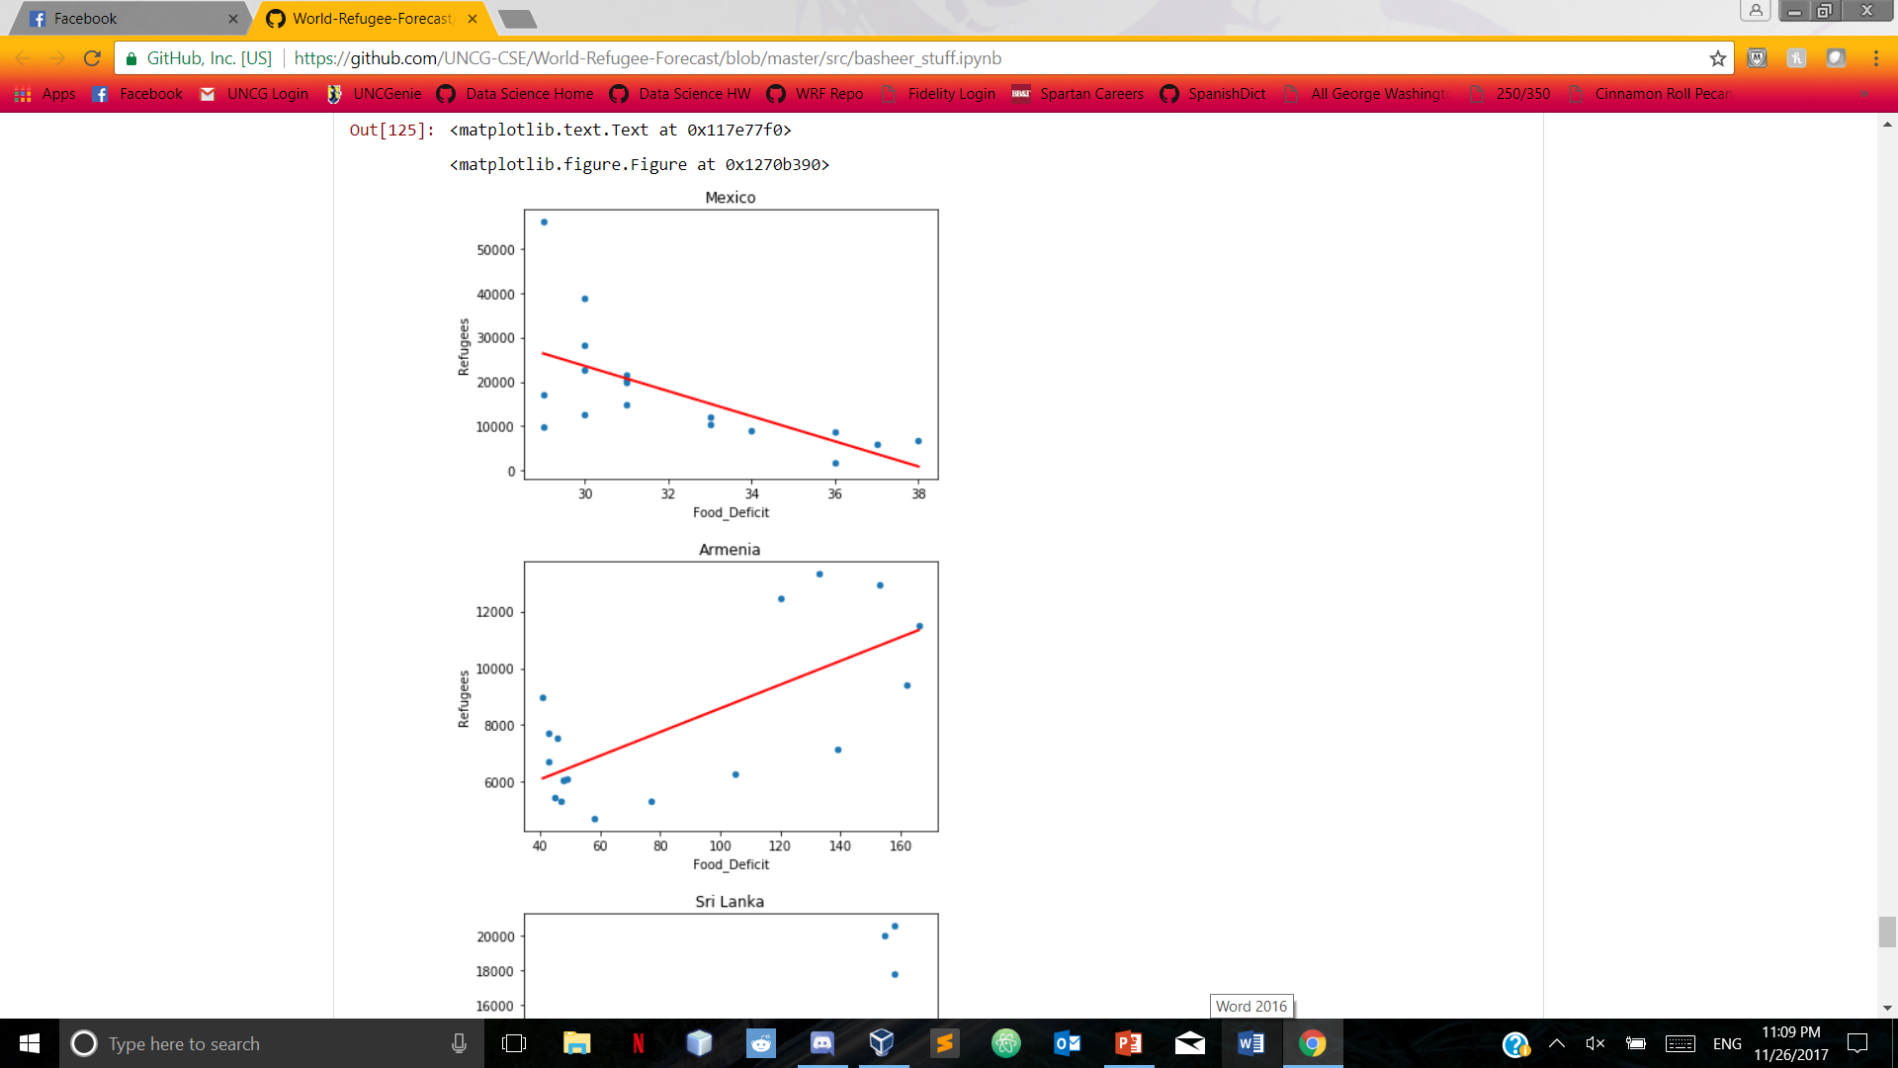
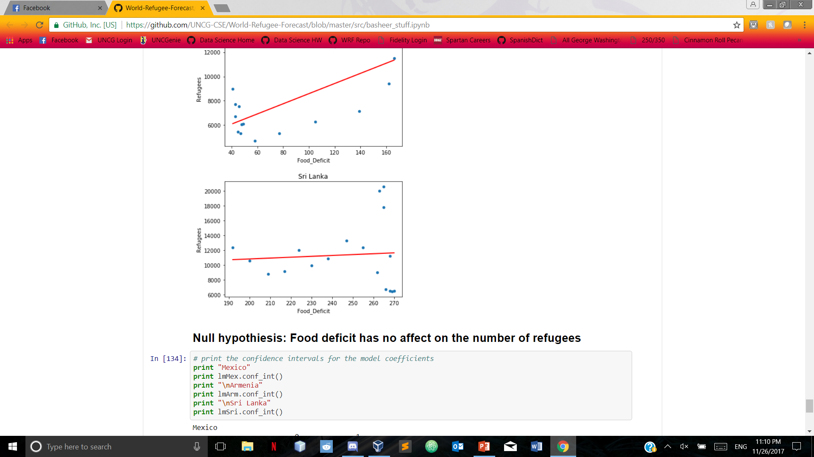
Food Deficit: Mexico, Armenia, Sri Lanka

Slide 22
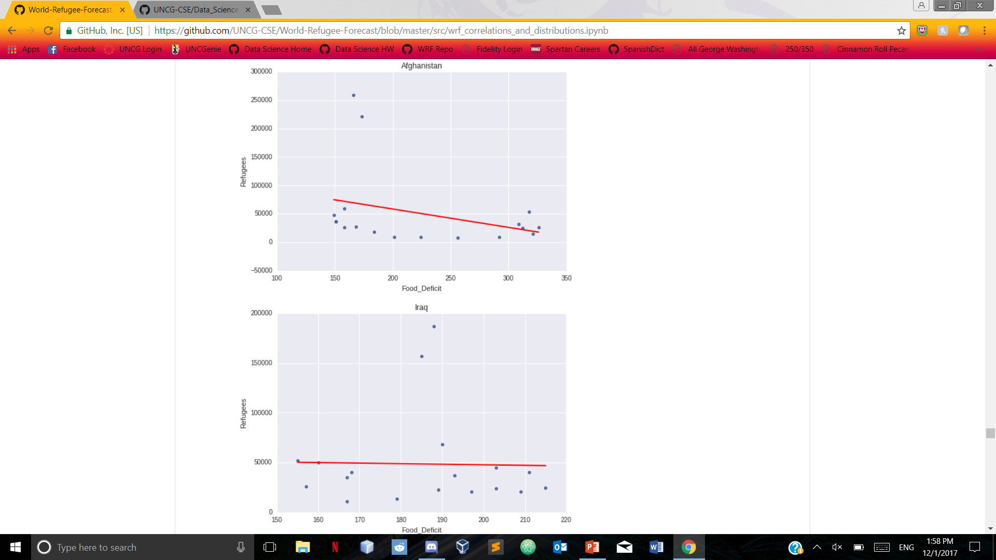
Food Deficit: Afghanistan and Iraq

Slide 23
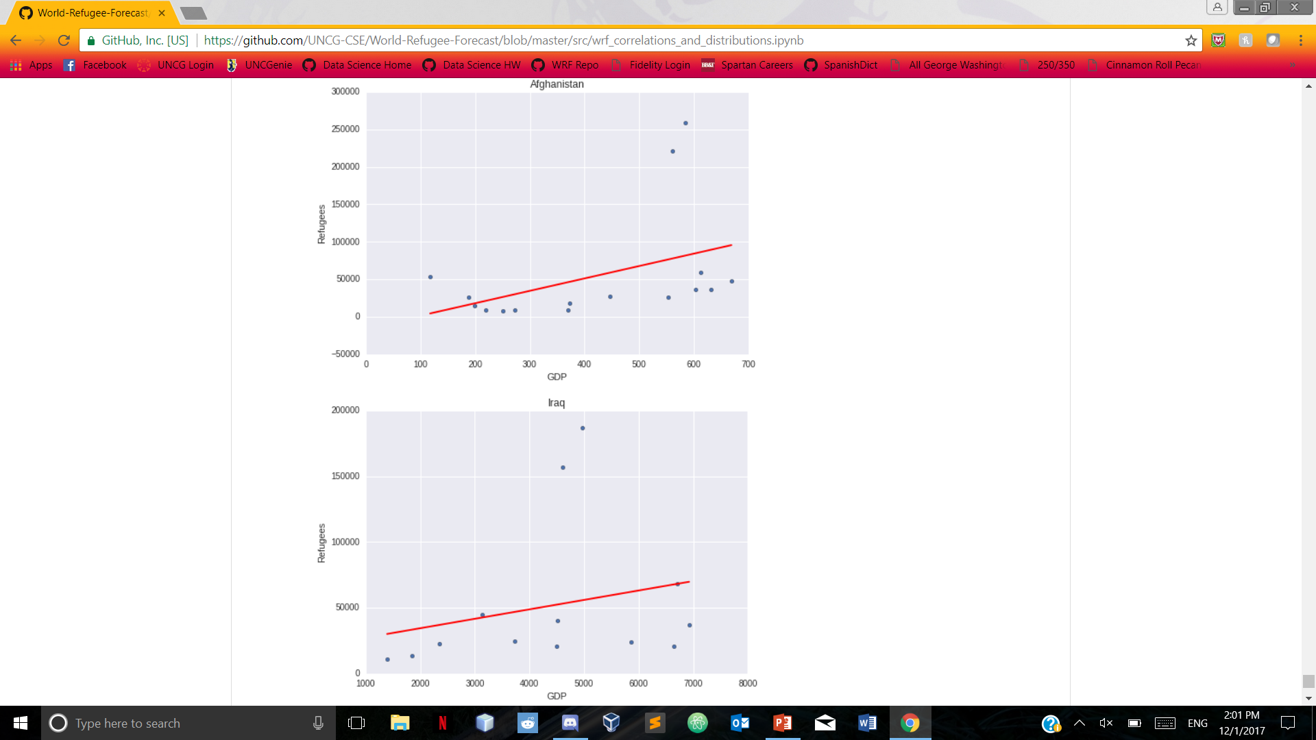
GDP: Afghanistan and Iraq

Slide 24
Machine Learning
Originally were going to implement SGD classifier
Added distance data, data was reduced
Decided to implement KNeighbors Classifier instead

Slide 25
Kneighbors Classifier
Country of asylum ~ Value+Country of Origin + Month leaving + km dist
Cross-validation score: 0.99148933467302047 (Seemed to fit the hold out data)
Test Score: 33796 / 34310 correct (Model seems to fit training data)

Slide 26
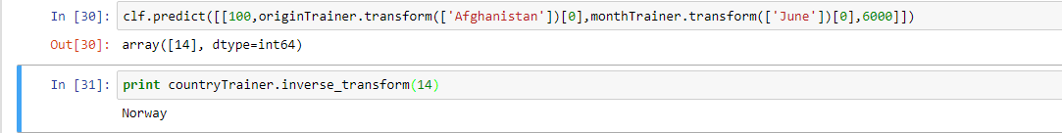
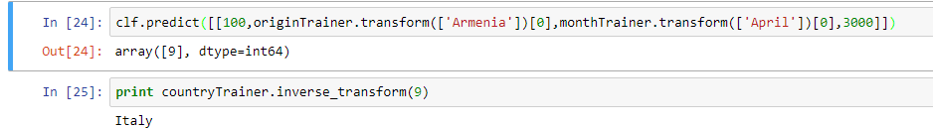

Slide 27
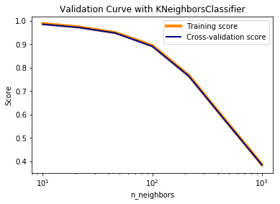
Validation curve
Model is under fitted so it is not complex enough to represent the data and it is high bias.
This means that the model is consistent, but inaccurate. We needed more features

Slide 28
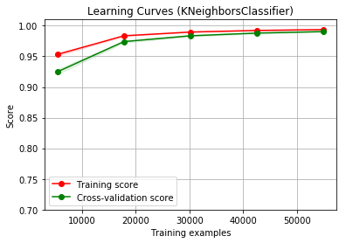
Learning Curve
100 iterations of cross validation
Learning curve is slightly over fitted at the beginning, but becomes under fitted by the end of the learning curve so adding more data points will not increase the model’s effectiveness

Slide 29
In Conclusion
Challenges:
Python is relatively new to the majority of us
Initial question was complicated to answer
More accurately predict where they’re coming from and where they’re going to
In the future:
Now understand how to accomplish something like this on the technical side
How to interpret results to improve our model

